Slide 1
One-stage detectors
SSD, YOLO

Slide 2
Detection: Taxonomy
Detectors
Two-Stage (Proposal-based)
RCNN
Fast RCNN
Faster RCNN
Mask RCNN
One-Stage
SSD
YOLOv3
DSOD
RFBNet
Points-based
CenterNet
CornerNet
ExtremeNet
EfficientDet (NAS)
Time

Slide 3
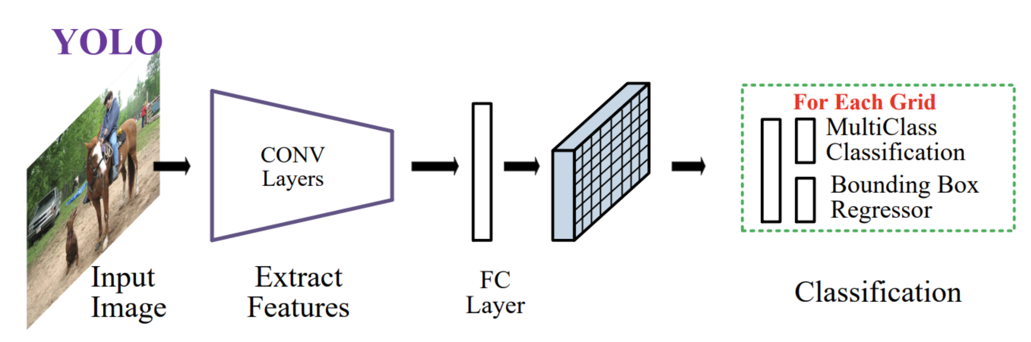
Detection: You Only Look Once
Get features from a Backbone Network
Predict feature map (“grid”)
Predict boxes from grid
Post-process predictions
https://arxiv.org/abs/1905.05055

Slide 4
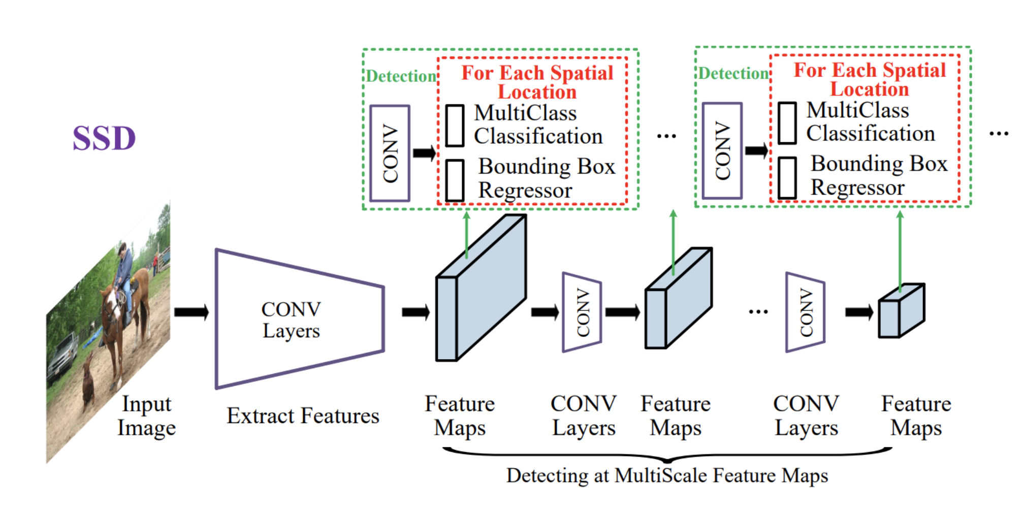
Detection: Single-Shot Multibox Detector (SSD)
Get features from a Backbone Network
Predict feature map (“grid”)
Predict boxes from grid
Post-process predictions
https://arxiv.org/abs/1905.05055

Slide 5
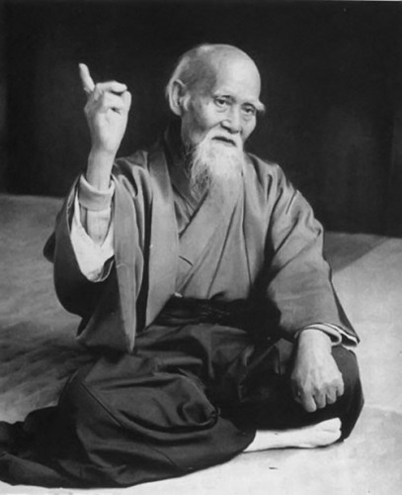
“Hone one thing,
but to the ideal”
Some clever person

Slide 6
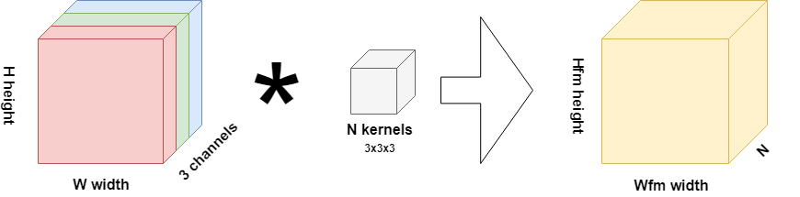
Convolutions: recap
cell
image
conv kernels (filters)
feature map
Notes:
Image, Conv, Pool, Shortcut, Feature map, conv6_4, Feature map Cell, Receptive field

Slide 7
Convolutions: recap
cell
image
conv kernels (filters)
feature map
Notes:
Image, Conv, Pool, Shortcut, Feature map, conv6_4, Feature map Cell, Receptive field

Slide 8
Convolutions: recap
image
conv kernels (filters)
feature map
Notes:
Image, Conv, Pool, Shortcut, Feature map, conv6_4, Feature map Cell, Receptive field

Slide 9
Convolutions: recap
cell
image
conv kernels (filters)
feature map
Notes:
Image, Conv, Pool, Shortcut, Feature map, conv6_4, Feature map Cell, Receptive field

Slide 10
SSD: up-to-bottom explanation
SSD pipeline
Input: image (h,w,3) → Backbone
Backbone → feature map
Feature map → boxes locations and classes inside of them
Detection task
How many boxes?
What should be the size of an input image?
How to train? (~ how to make it differentiable?)

Slide 11
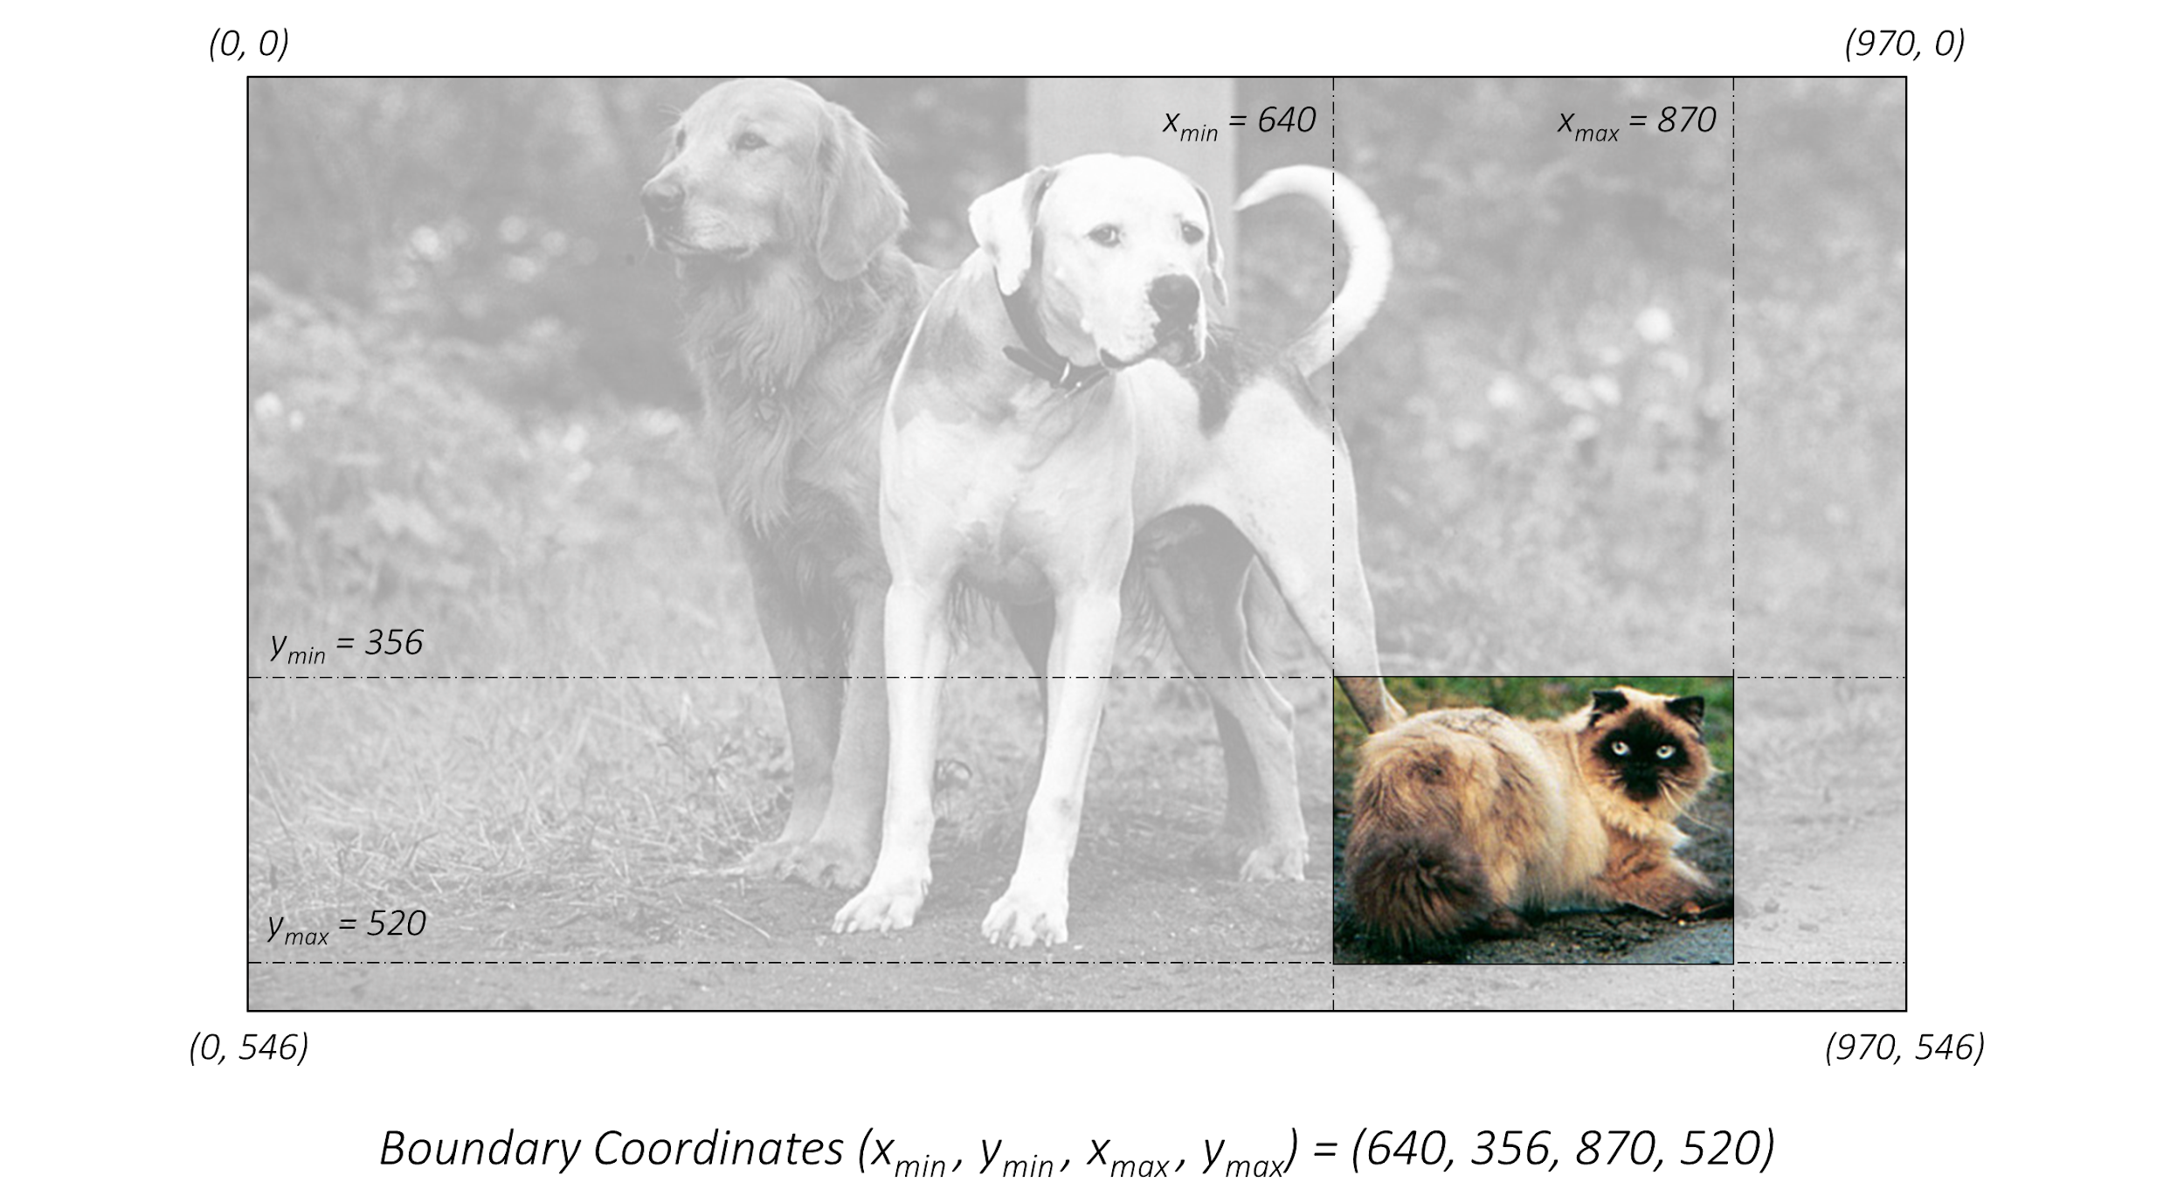
SSD: tlrb format
https://github.com/sgrvinod/a-PyTorch-Tutorial-to-Object-Detection

Slide 12
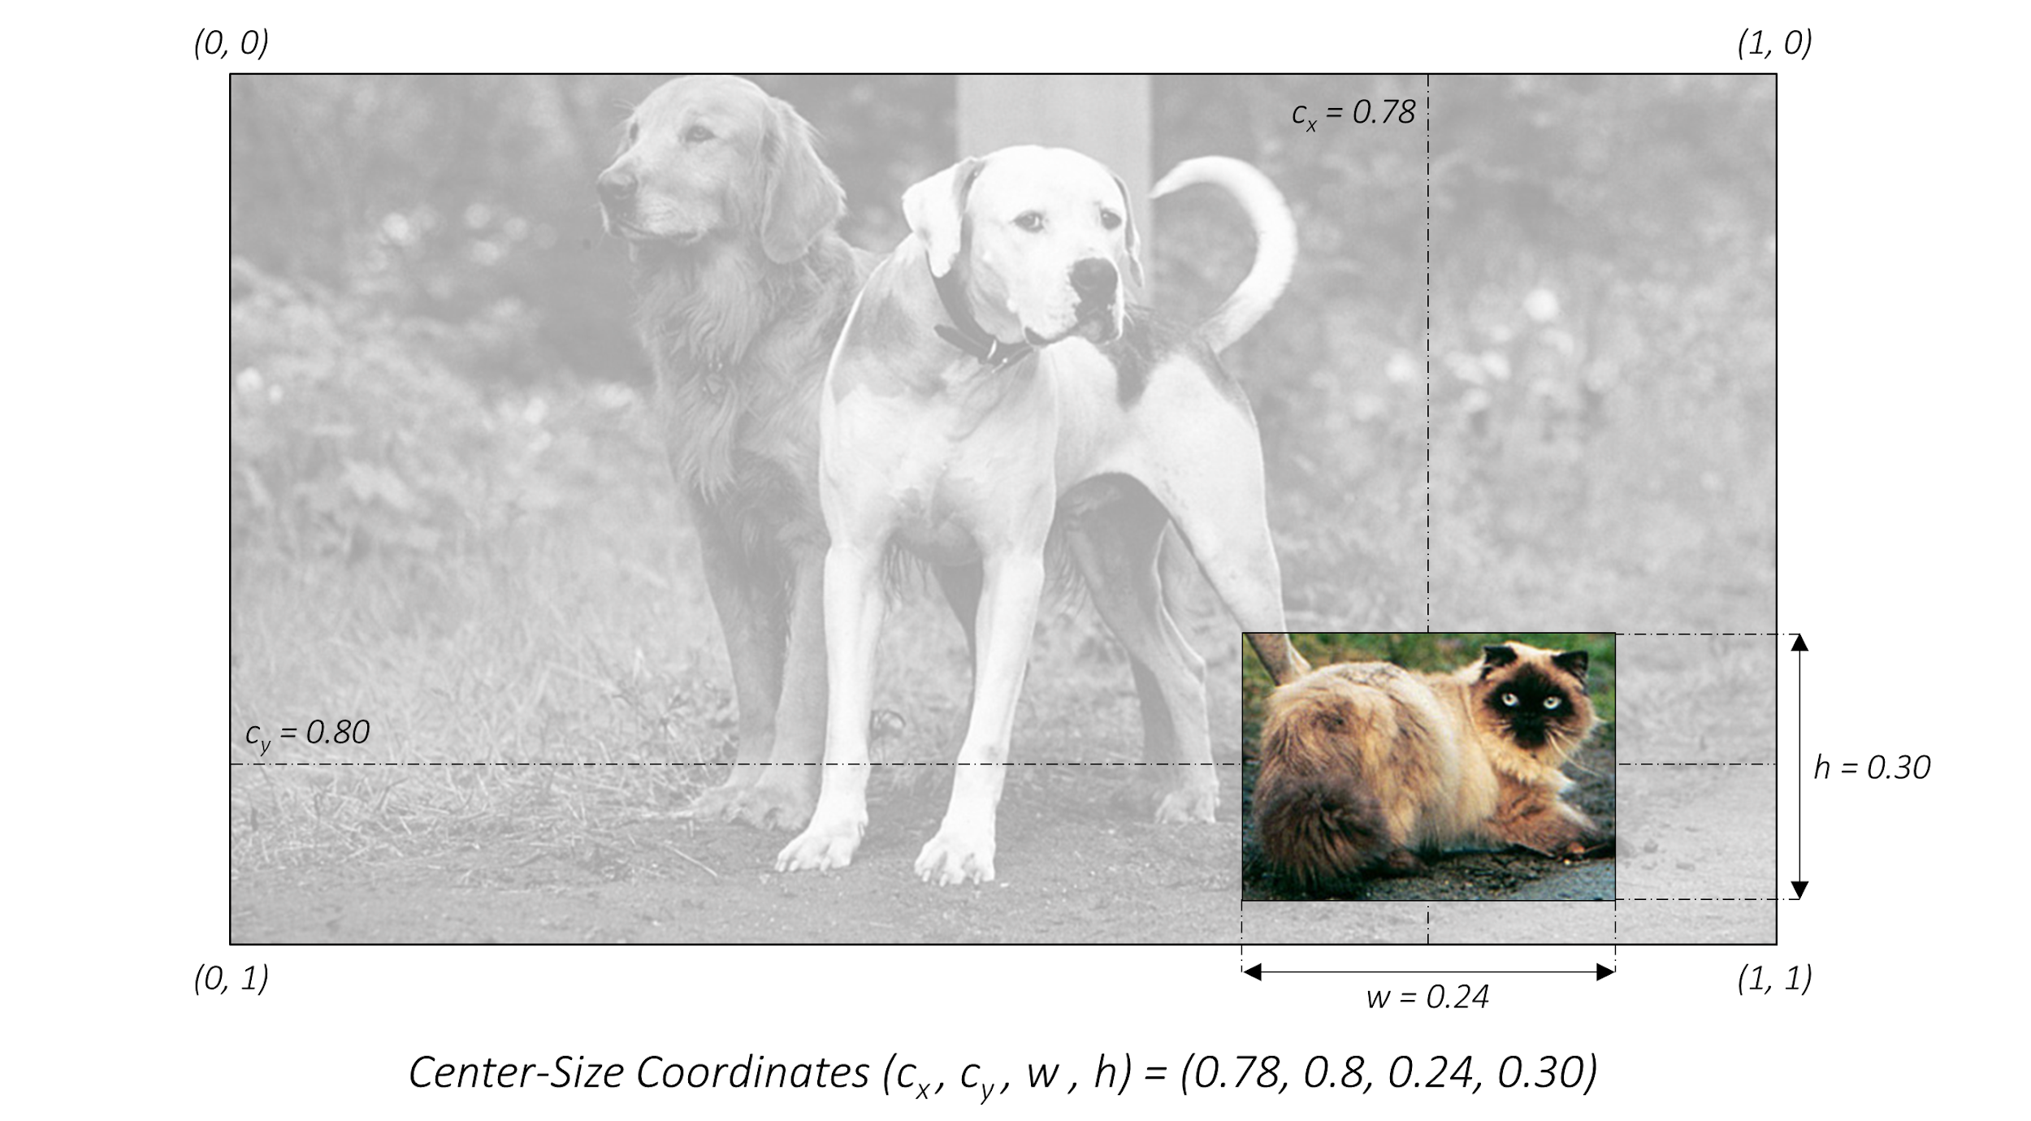
SSD: xywh format
https://github.com/sgrvinod/a-PyTorch-Tutorial-to-Object-Detection

Slide 13
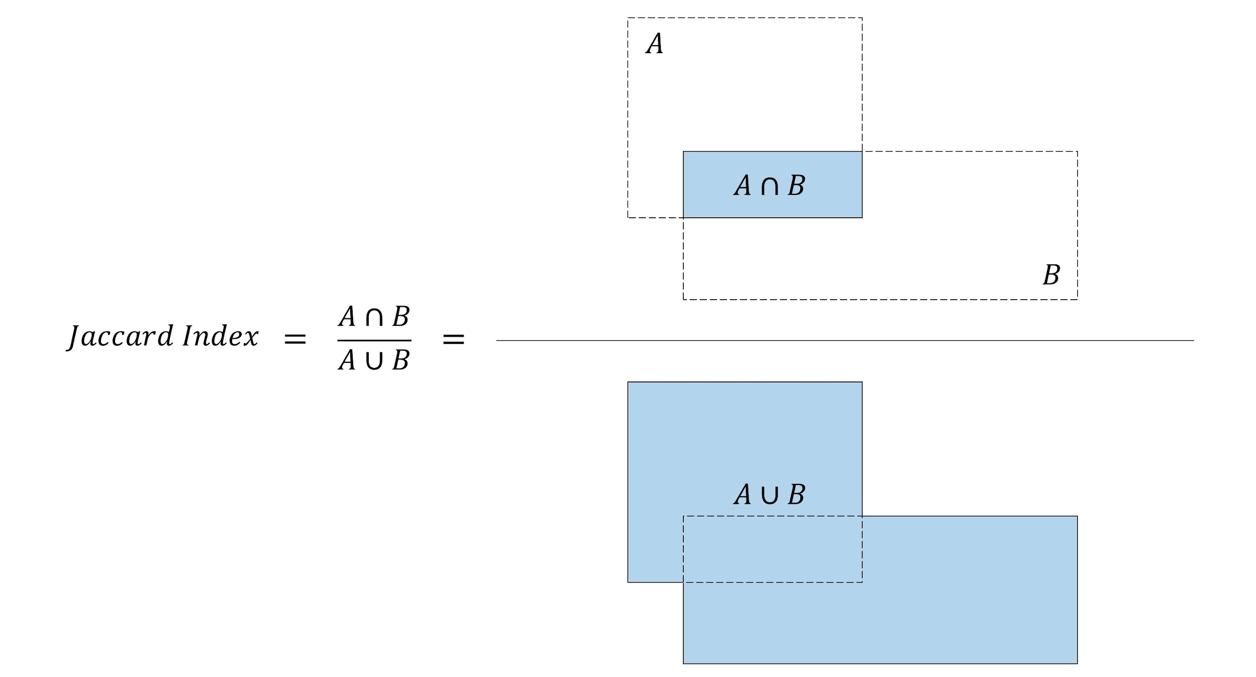
SSD: Intersection over Union
https://github.com/sgrvinod/a-PyTorch-Tutorial-to-Object-Detection

Slide 14
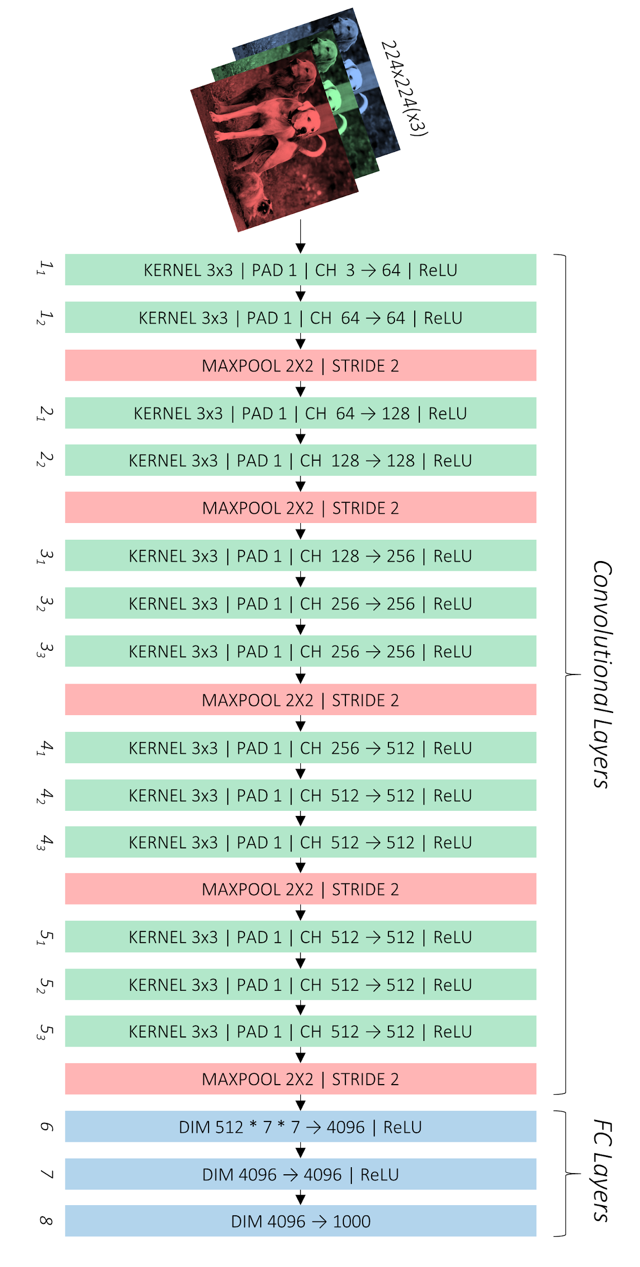
SSD: VGG
https://github.com/sgrvinod/a-PyTorch-Tutorial-to-Object-Detection

Slide 15
SSD: VGG
https://github.com/sgrvinod/a-PyTorch-Tutorial-to-Object-Detection

Slide 16
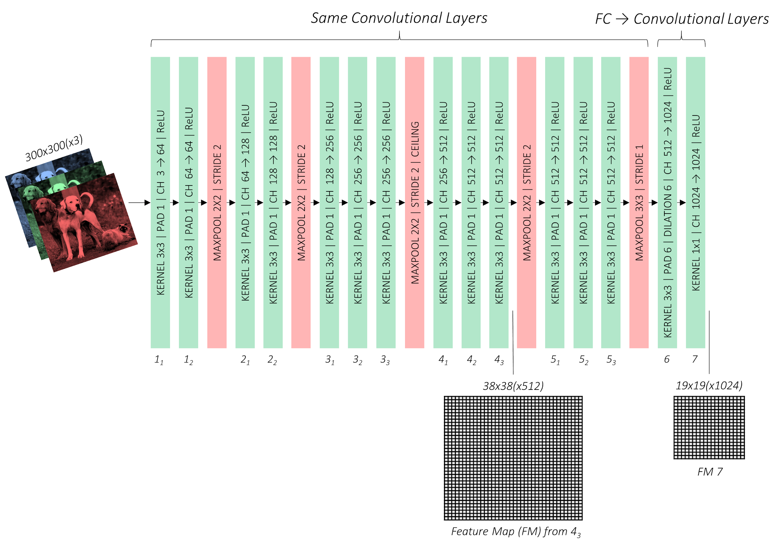
SSD
https://github.com/sgrvinod/a-PyTorch-Tutorial-to-Object-Detection

Slide 17
SSD: VGG
https://github.com/sgrvinod/a-PyTorch-Tutorial-to-Object-Detection

Slide 18
SSD: VGG
Auxiliary Layers
https://github.com/sgrvinod/a-PyTorch-Tutorial-to-Object-Detection

Slide 19
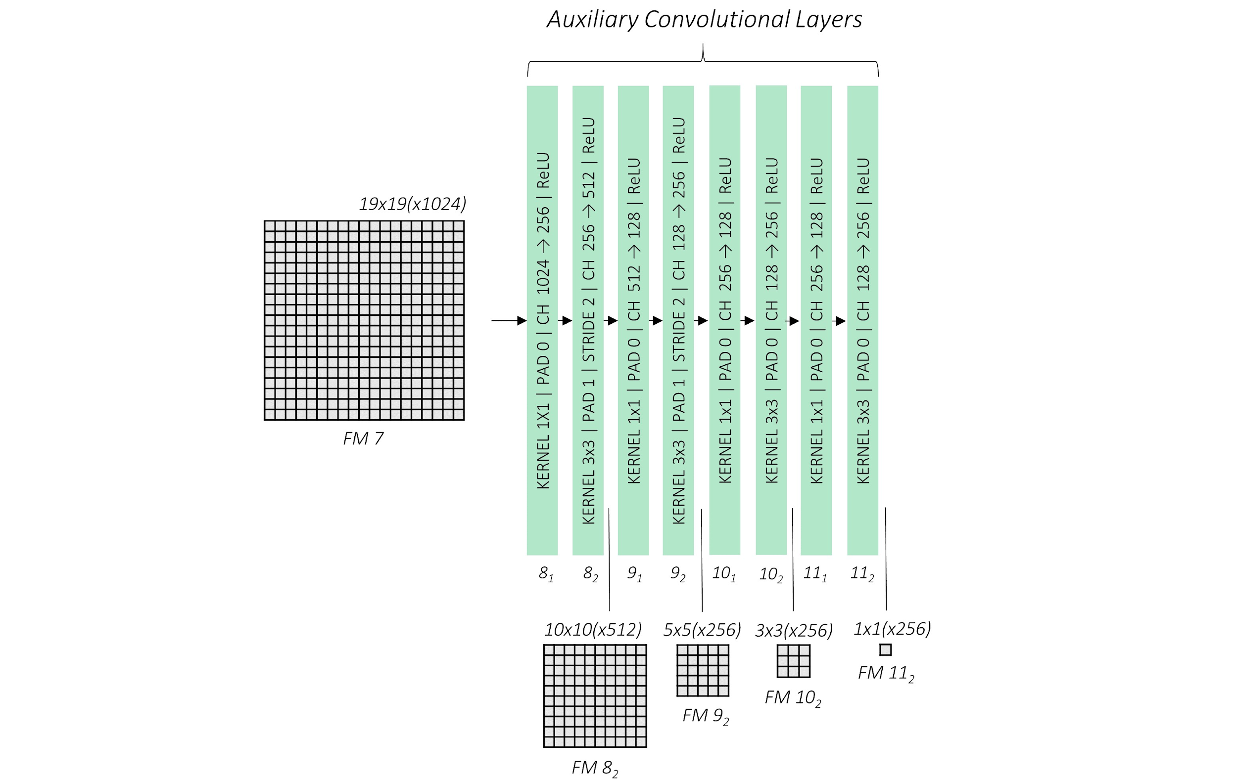
SSD: auxiliary (“extra”) layers
https://github.com/sgrvinod/a-PyTorch-Tutorial-to-Object-Detection

Slide 20
SSD: feature maps
https://github.com/sgrvinod/a-PyTorch-Tutorial-to-Object-Detection

Slide 21
SSD
Each of these feature maps’ cells has 4-6 “default boxes”
https://github.com/sgrvinod/a-PyTorch-Tutorial-to-Object-Detection

Slide 22
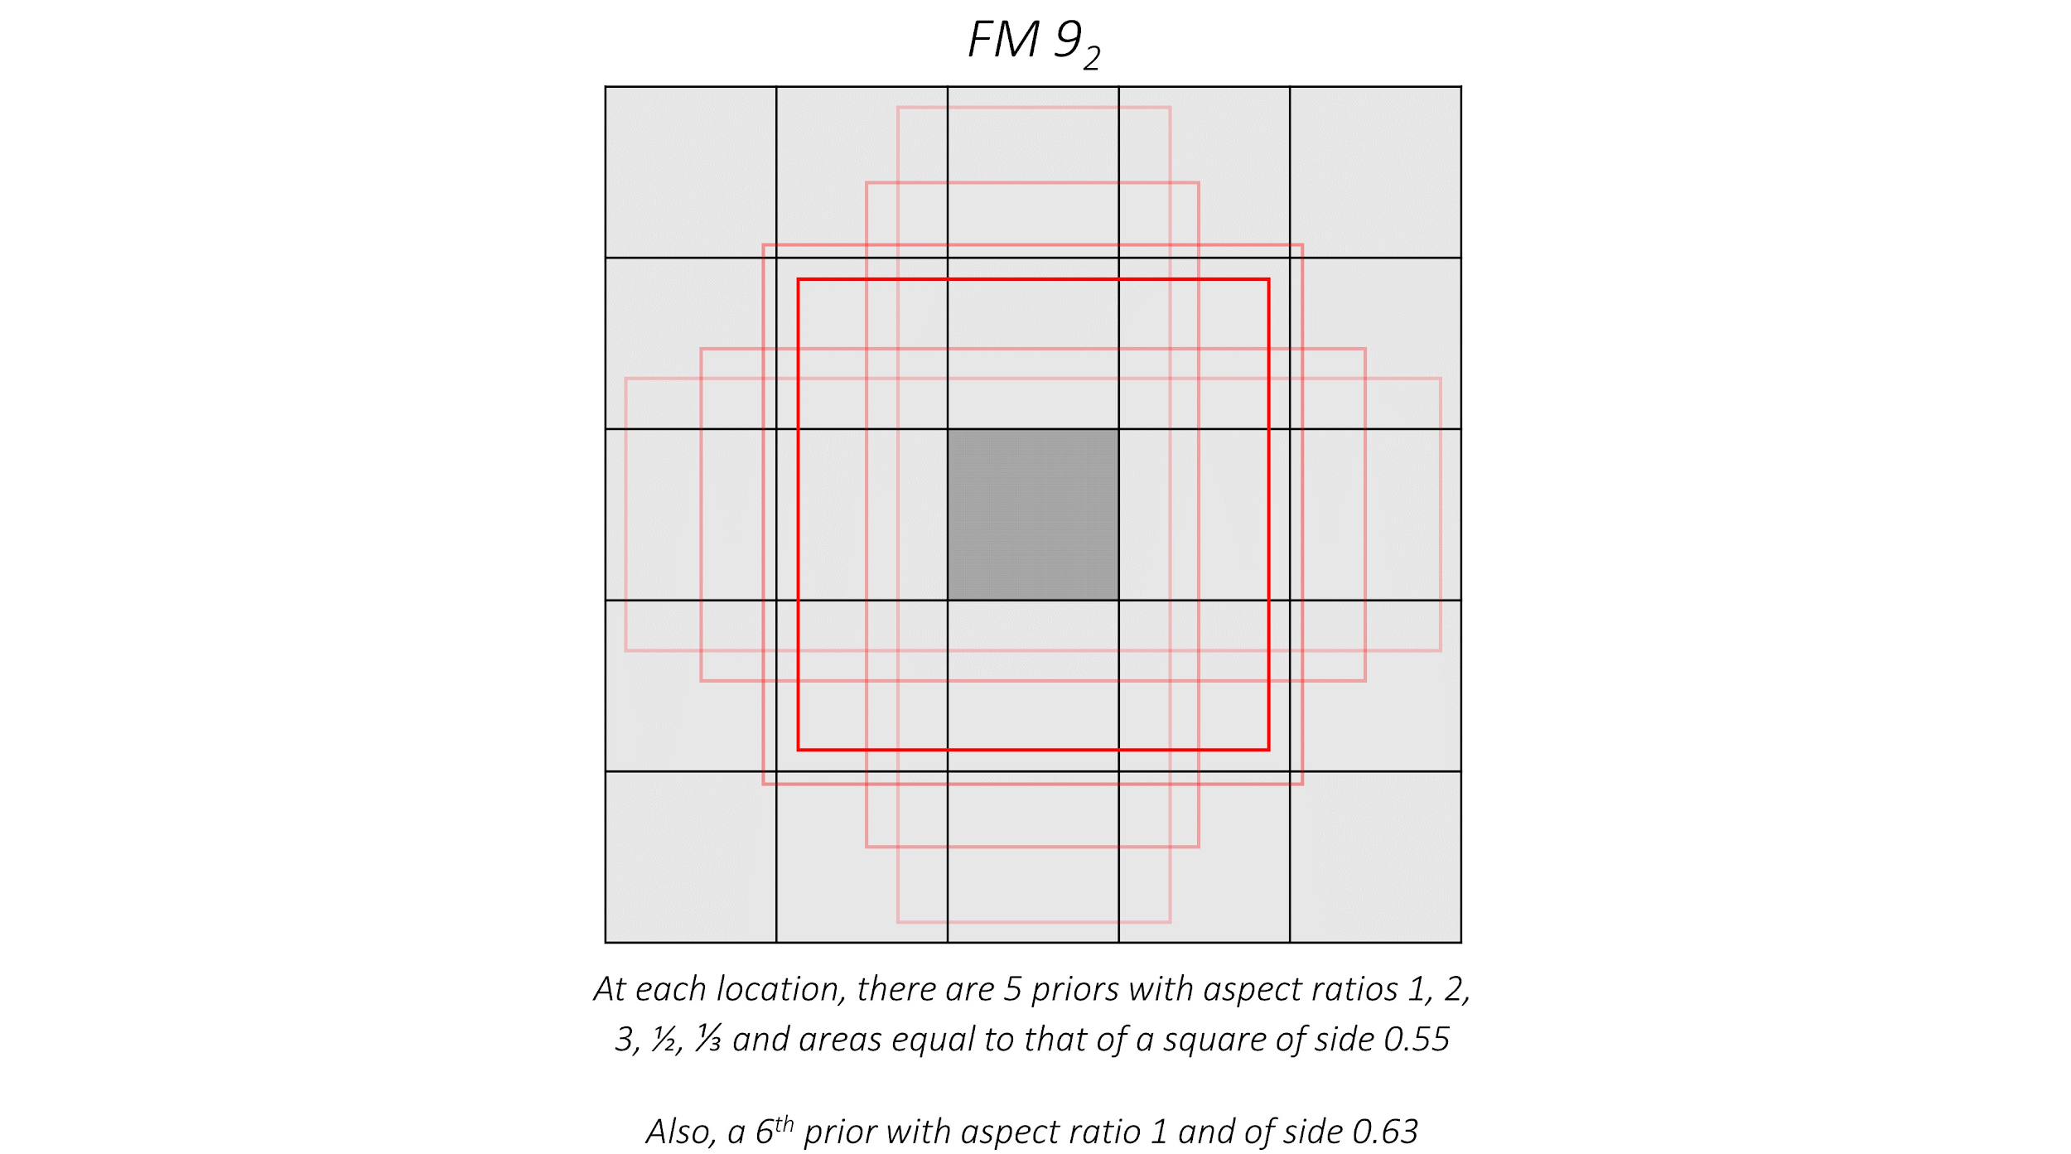
SSD: “default boxes” of one cell
Each of these feature maps’ cells has 4-6 “default boxes”
https://github.com/sgrvinod/a-PyTorch-Tutorial-to-Object-Detection

Slide 23
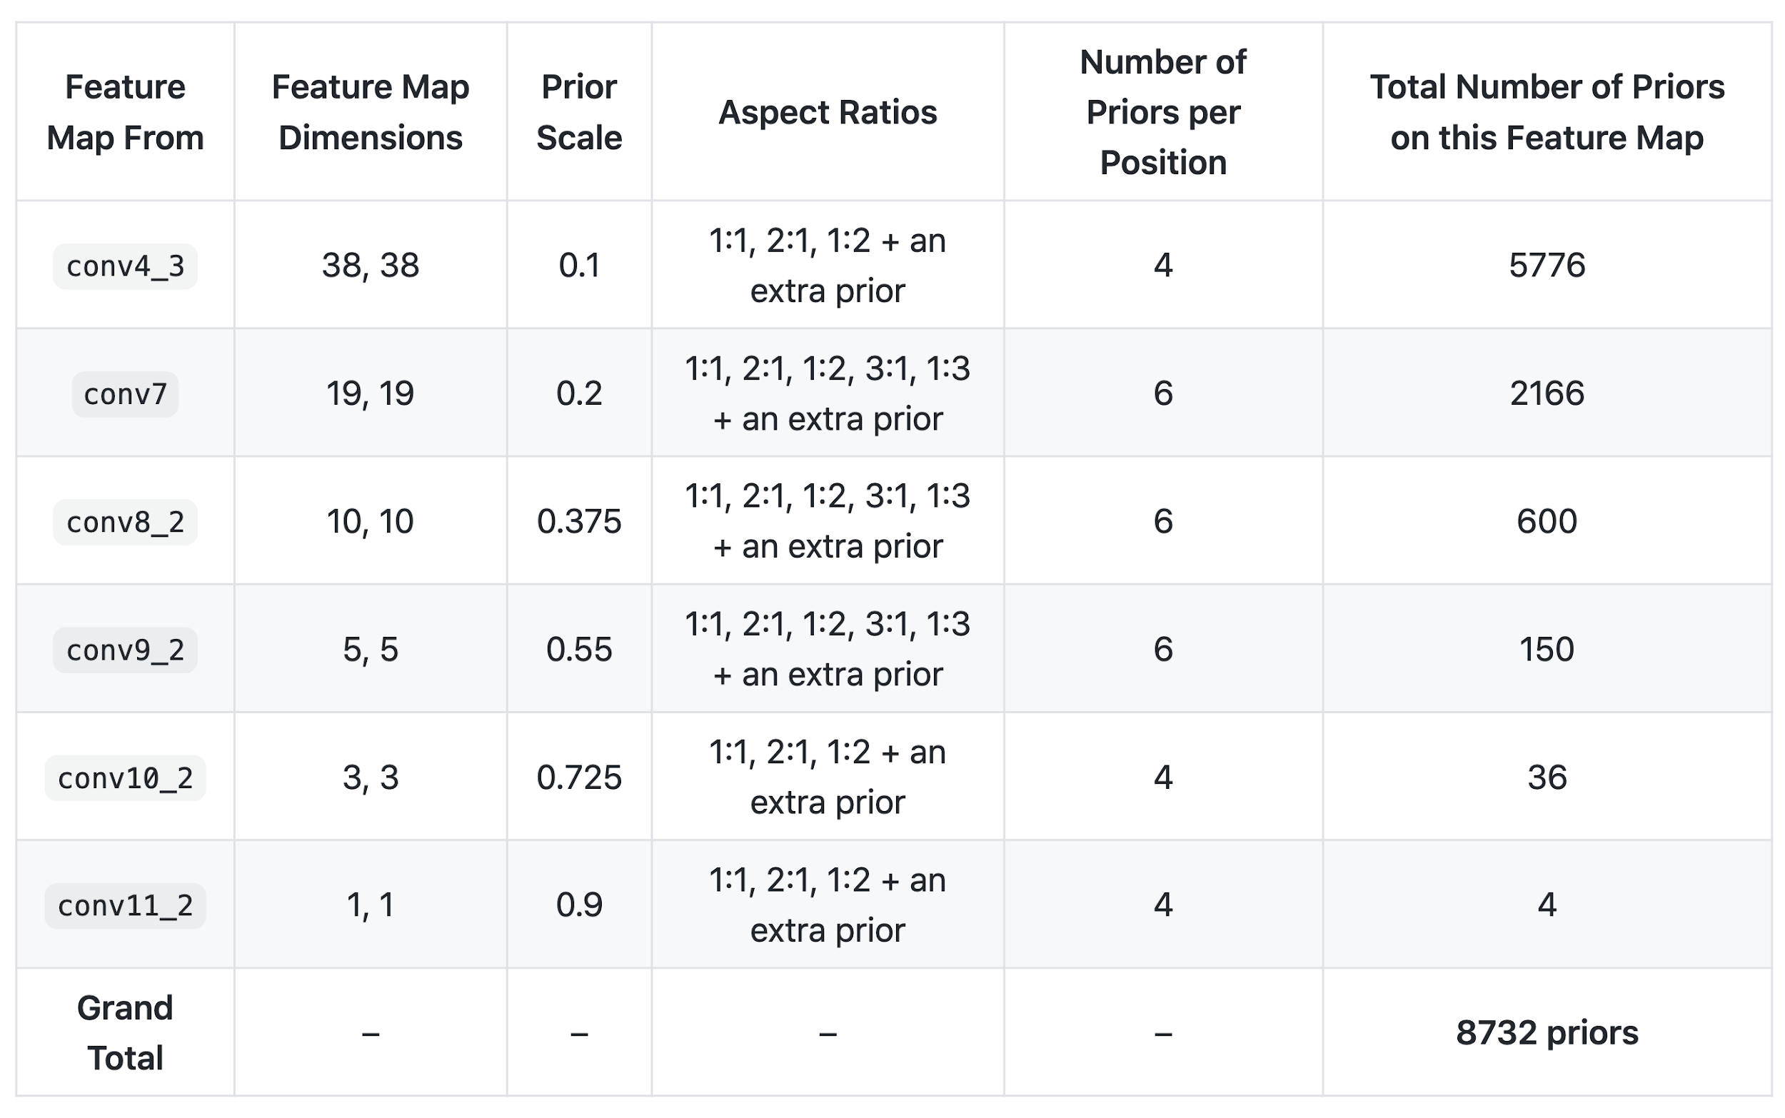
SSD: number of default boxes
https://github.com/sgrvinod/a-PyTorch-Tutorial-to-Object-Detection

Slide 24
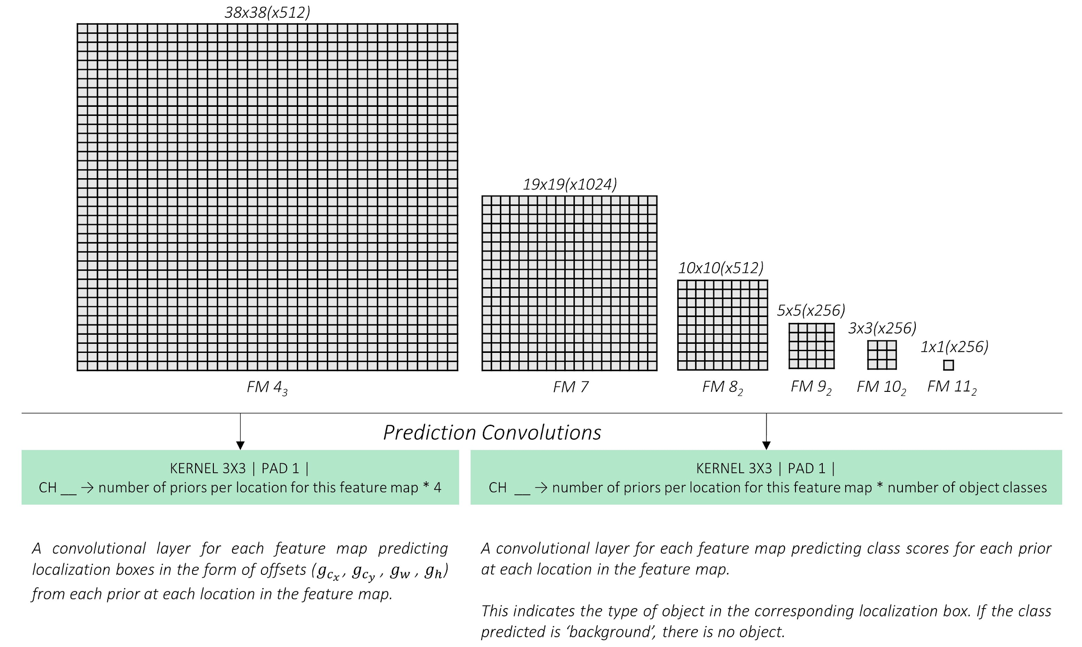
SSD: prediction convolutions
https://github.com/sgrvinod/a-PyTorch-Tutorial-to-Object-Detection

Slide 25
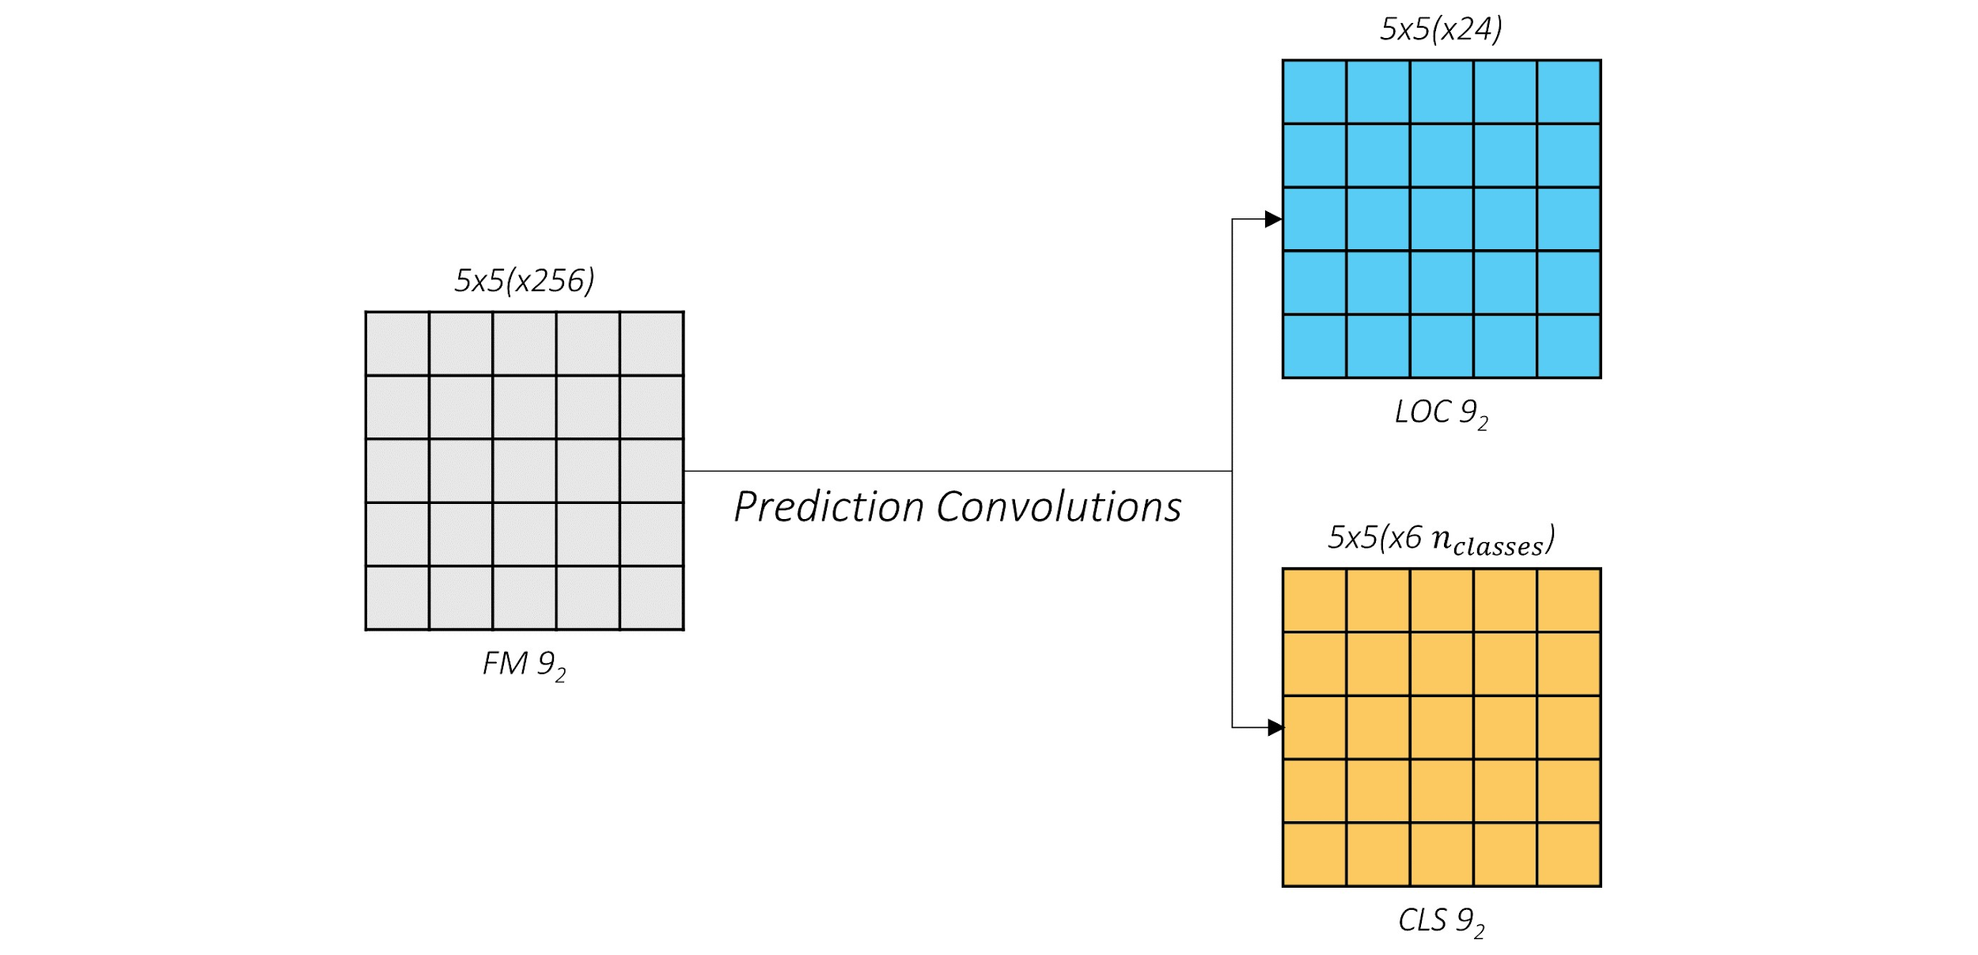
SSD: prediction scheme
https://github.com/sgrvinod/a-PyTorch-Tutorial-to-Object-Detection

Slide 26
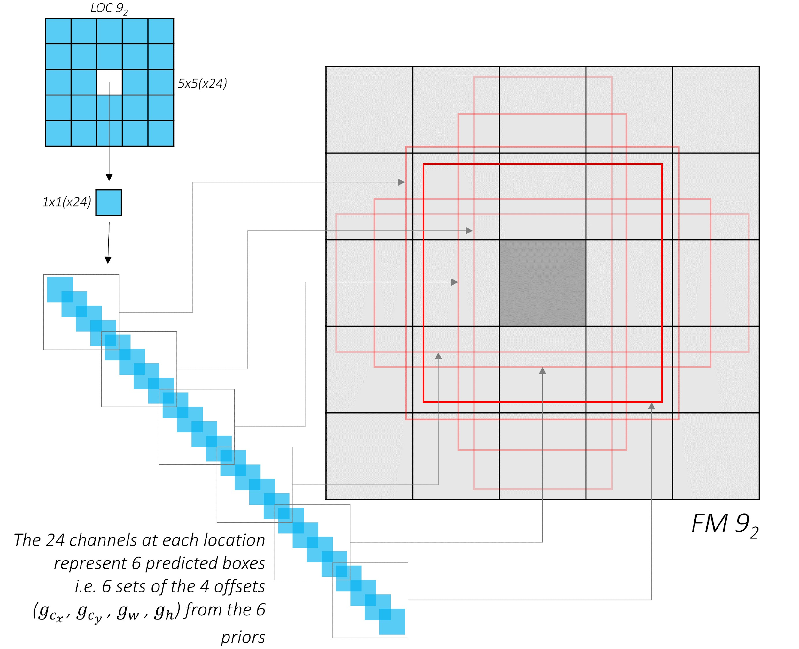
SSD: location coordinates channels
https://github.com/sgrvinod/a-PyTorch-Tutorial-to-Object-Detection

Slide 27
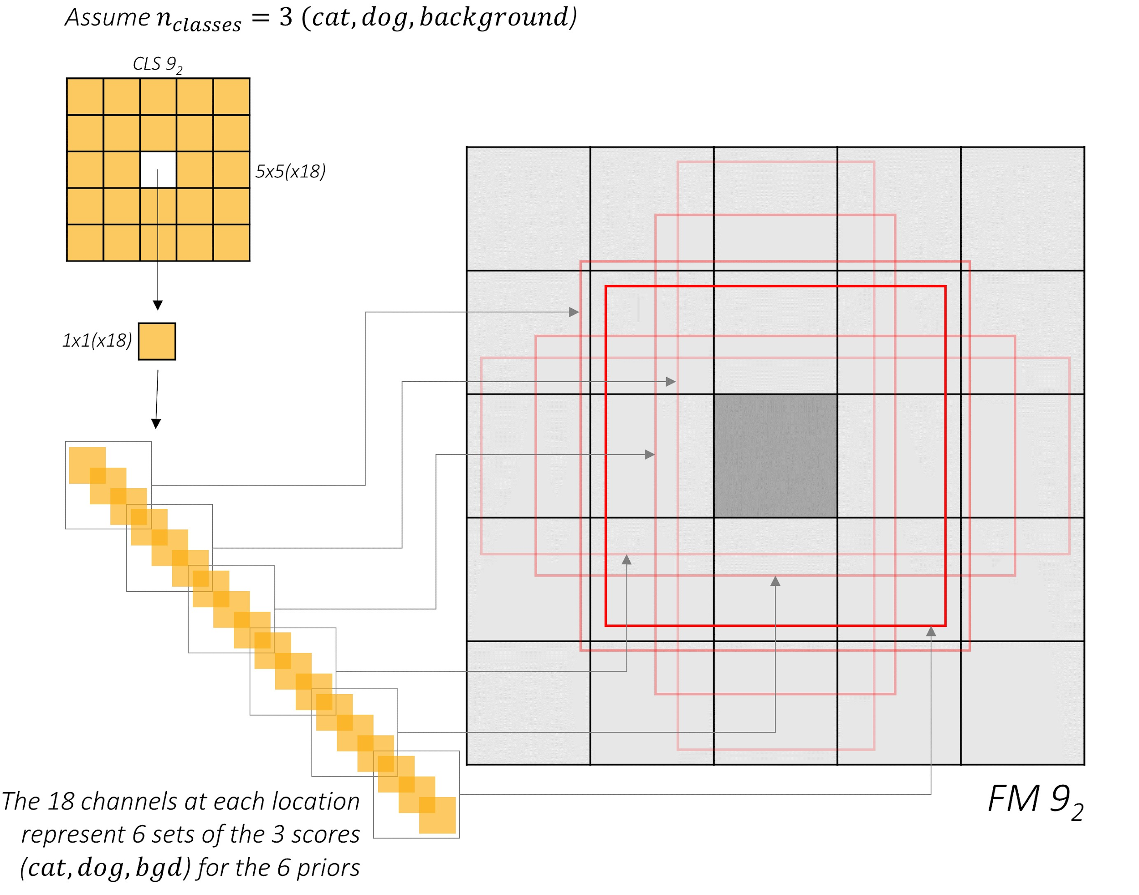
SSD: classification score channels
https://github.com/sgrvinod/a-PyTorch-Tutorial-to-Object-Detection

Slide 28
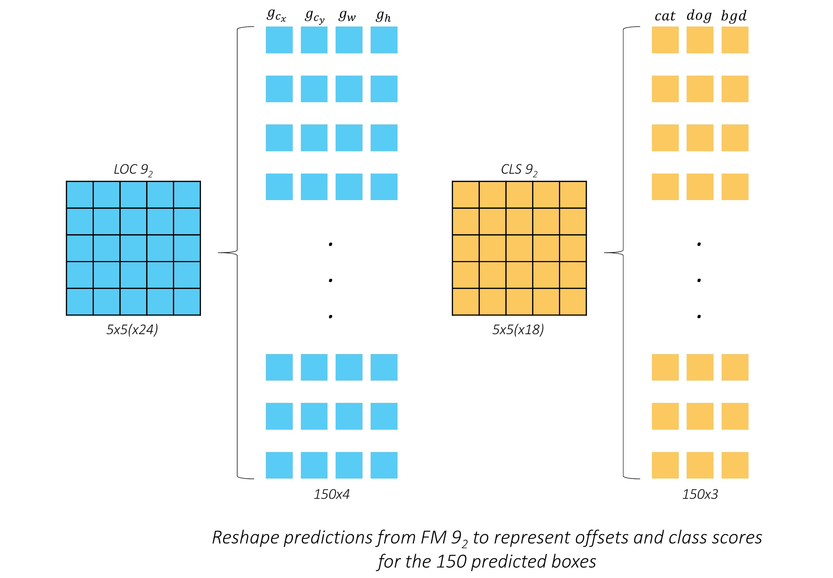
SSD: boxes of FM 9
https://github.com/sgrvinod/a-PyTorch-Tutorial-to-Object-Detection

Slide 29
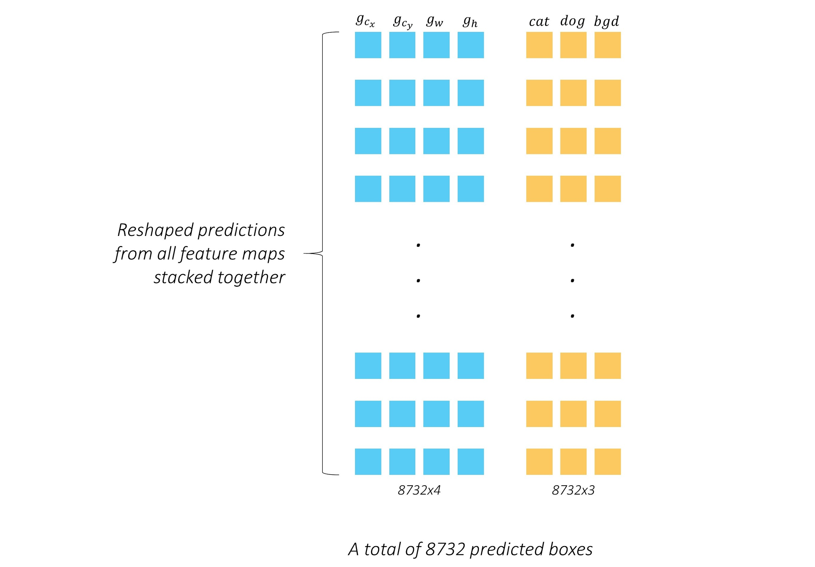
SSD: all predicted boxes
https://github.com/sgrvinod/a-PyTorch-Tutorial-to-Object-Detection

Slide 30
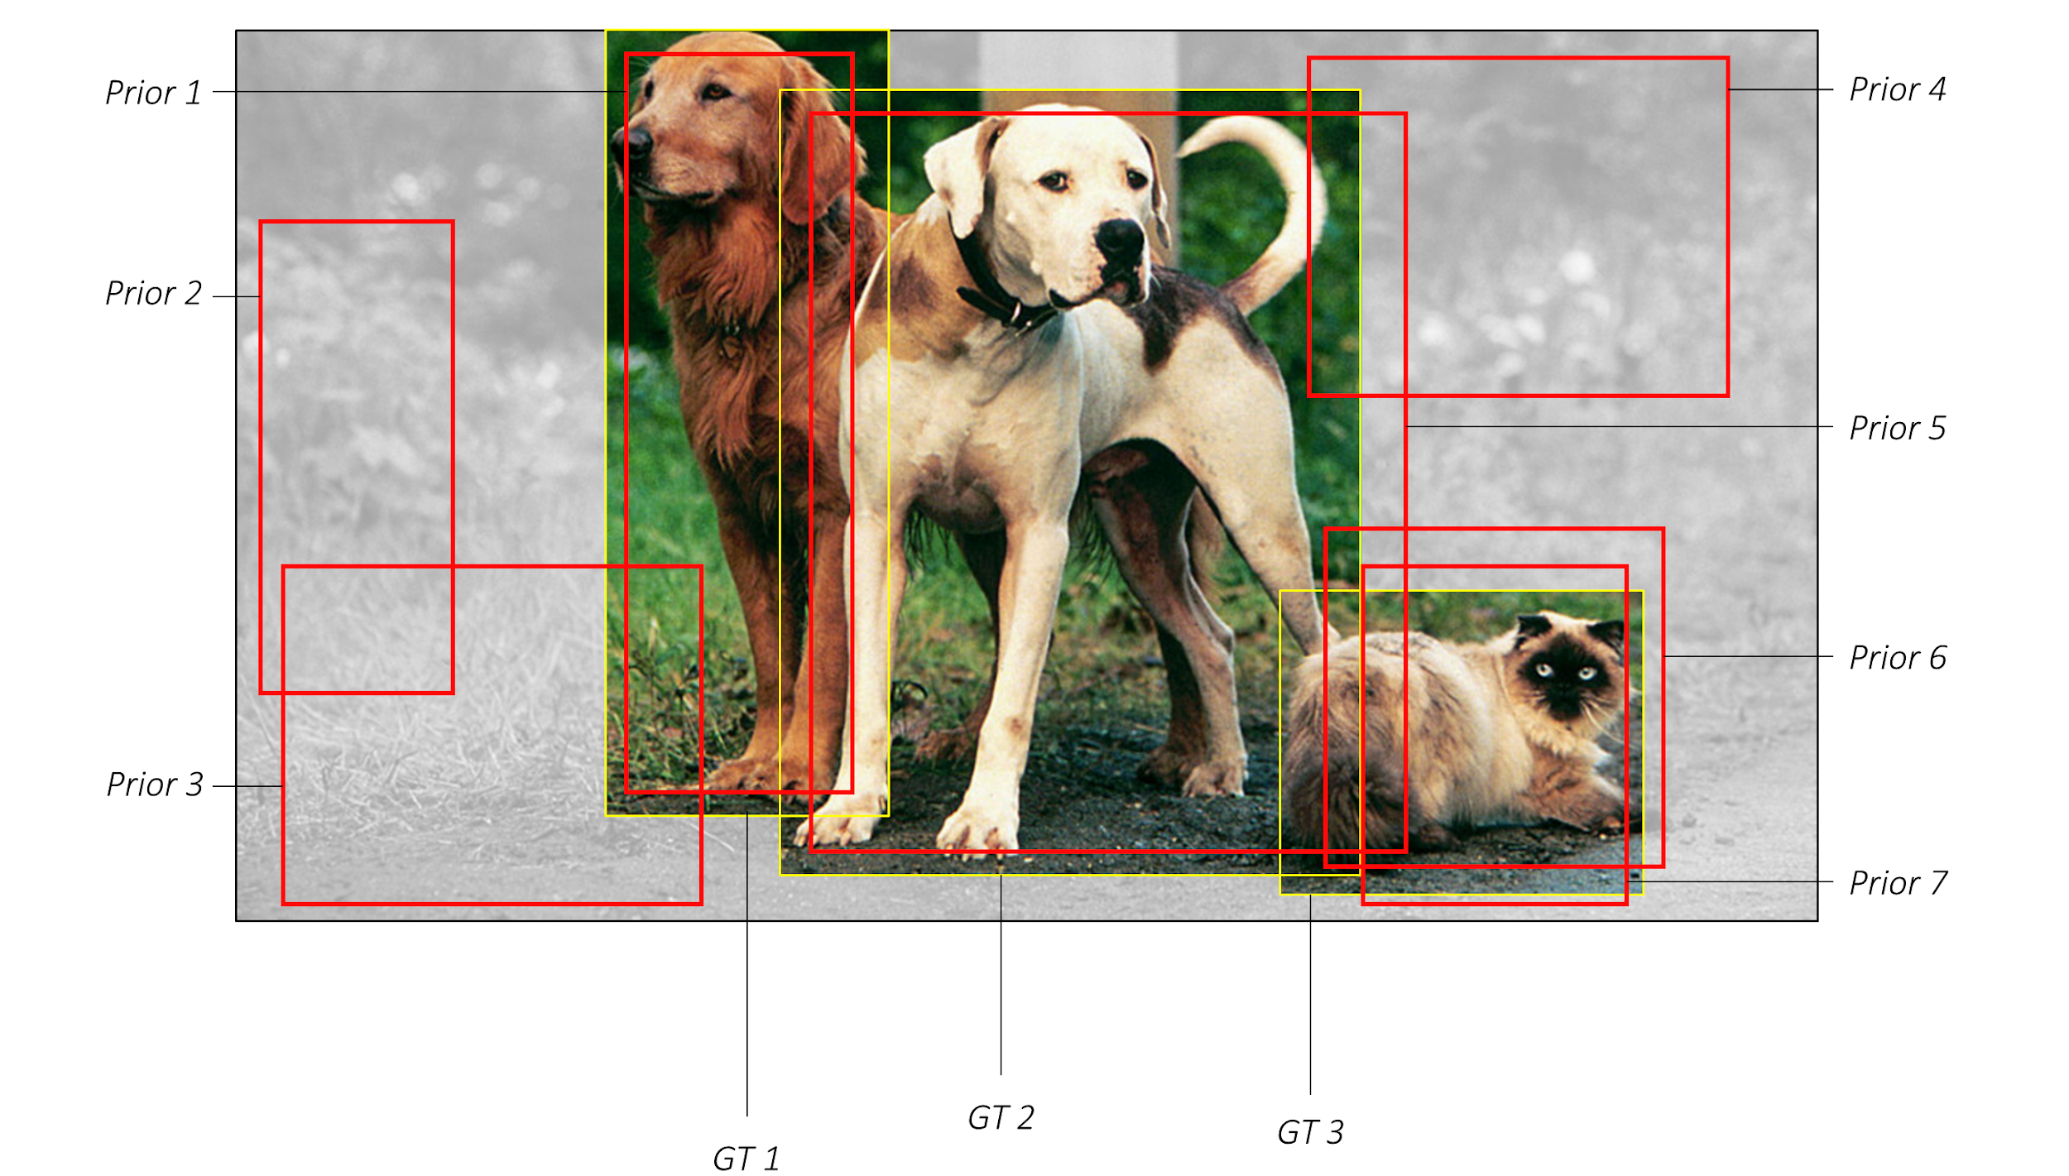
SSD: predictions
https://github.com/sgrvinod/a-PyTorch-Tutorial-to-Object-Detection

Slide 31
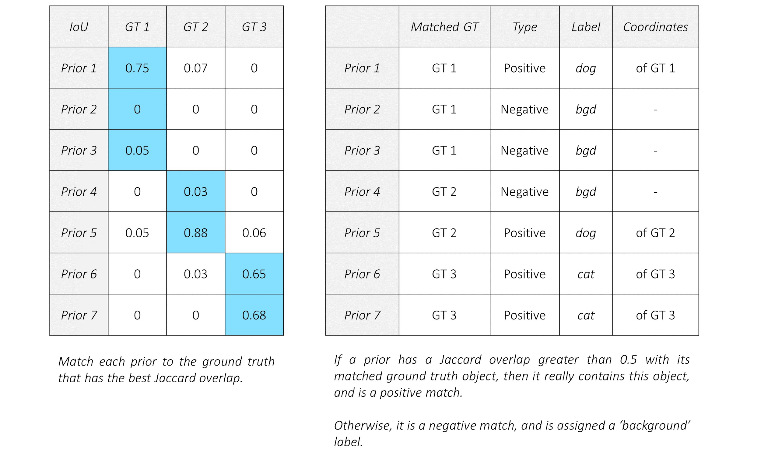
SSD: matching
https://github.com/sgrvinod/a-PyTorch-Tutorial-to-Object-Detection

Slide 32

SSD: coordinate regression loss
https://github.com/sgrvinod/a-PyTorch-Tutorial-to-Object-Detection

Slide 33
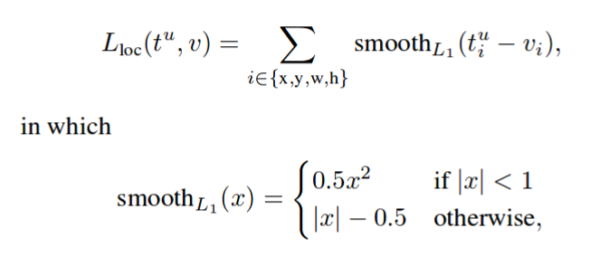
SSD: coordinate regression loss
https://github.com/sgrvinod/a-PyTorch-Tutorial-to-Object-Detection

Slide 34

SSD: classification loss + hard negative mining
https://github.com/sgrvinod/a-PyTorch-Tutorial-to-Object-Detection

Slide 35
SSD: classification loss + hard negative mining
https://github.com/sgrvinod/a-PyTorch-Tutorial-to-Object-Detection

Slide 36
SSD: classification loss + hard negative mining
N_hard_negatives = 3 * N_positives
https://github.com/sgrvinod/a-PyTorch-Tutorial-to-Object-Detection

Slide 37
SSD: full multibox loss
N_hard_negatives = 3 * N_positives
https://github.com/sgrvinod/a-PyTorch-Tutorial-to-Object-Detection

Slide 38
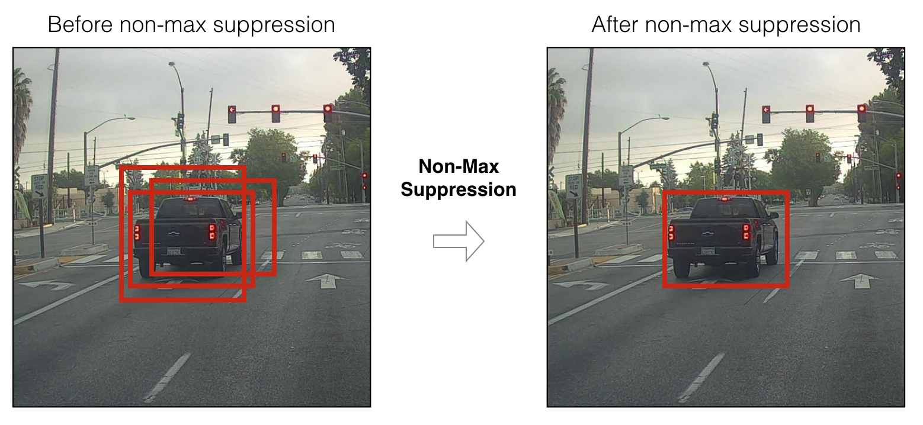
Detection: non-max suppression
For each class separately!

Slide 39
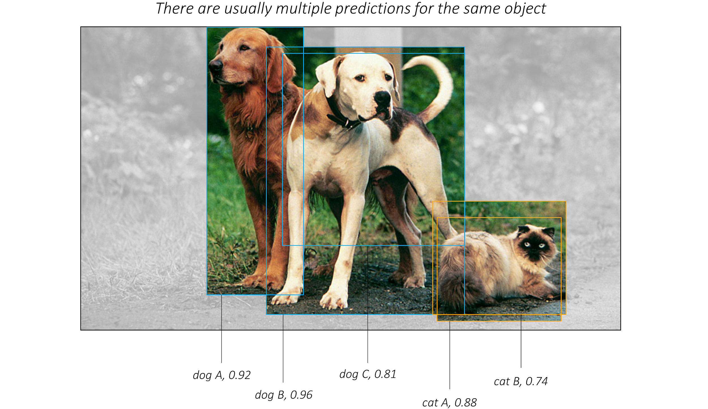
Detection: non-max suppression
https://github.com/sgrvinod/a-PyTorch-Tutorial-to-Object-Detection

Slide 40
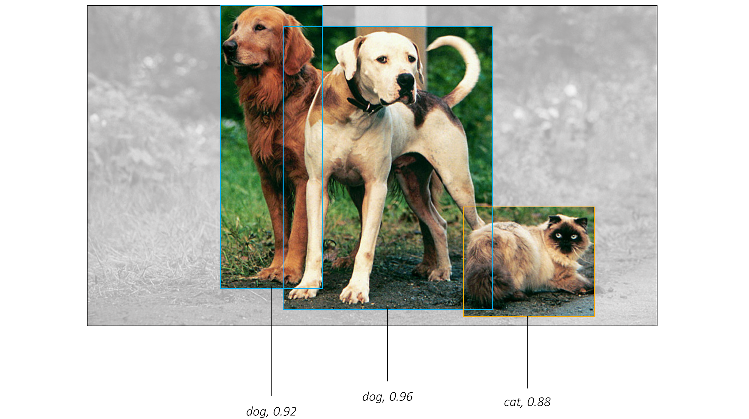
Detection: non-max suppression
https://github.com/sgrvinod/a-PyTorch-Tutorial-to-Object-Detection

Slide 41
Summary
One-stage detectors
In-depth SSD architecture

